Slide 1

COP 6731: Theory and Implementation of Database Systems
Relational Algebra

Slide 2
Relational Algebra
Relation algebra is the basic set of operations for the formal relational model. It provides a basis for implementing and optimizing queries.
Operation | Notation
Selection | σ
Projection | π
Rename | ← or ρ
Set Operations | ⋃ ∩ –
Division | /
Cartesian Product | ✕
Join | ⋈
Outer Join | ⟕ ⟖ ⟗

Slide 3
Relational Algebra
Since each operation returns a relation, operations can be composed! (Algebra is “closed”.)
Relation
Relational Algebra
Relation

Slide 4
Selection operation
A subset of tuples from a relation that satisfies a selection condition.
σ_{<selection condition>} Relation
σ_{Dno=4} Employee
σ_{Dno=4 AND Salary>25000} Employee
σ(Dno=4 AND Salary>25000) OR (Dno=5 AND Salary>30000) Employee

Slide 5

Selection operation
Commutative
σ_{Dno=4} σ _{Salary>25000} Employee
σ_{Salary>25000} σ_{Dno=4} Employee
A sequence of SELECT can be a single SELECT.
σ_{Dno=4 AND Salary>25000} Employee

Slide 6
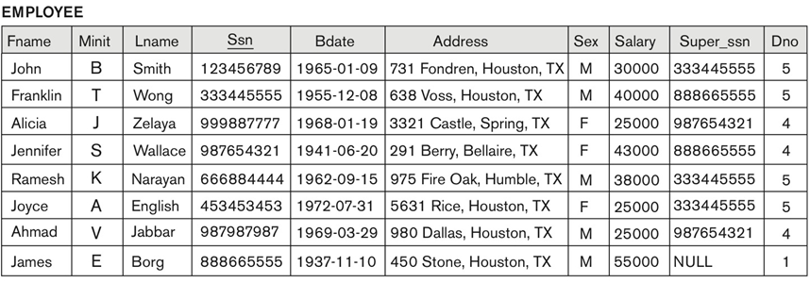
Example
σ_{Dno=4} Employee

Slide 7
Example
σ_{Dno=4 AND Salary>25000} Employee

Slide 8
Example
σ(Dno=4 AND Salary>25000) OR (Dno=5 AND Salary>30000) Employee

Slide 9
Projection operation
A subset of columns from a relation
π_{<attribute list>} Relation
π_{Lname,Fname,Salary} Employee

Slide 10
SQL Query for the Projection operation
π_{Sex,Salary} Employee

Slide 11
Example
π_{Lname,Fname,Salary} Employee

Slide 12
Example
π_{Sex,Salary} Employee

Slide 13
Assignment operation
π_{Fname,Lname,Salary} σ_{Dno=4} Employee
ED5 ← σ_{Dno=4} Employee
π_{Fname,Lname,Salary} ED5

Slide 14
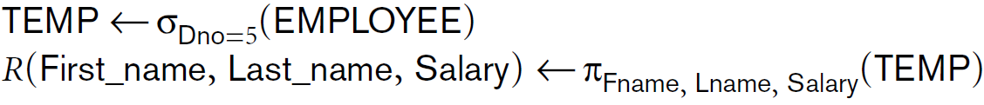

Rename operation

Slide 15
Set operations
Operation | notation
Union | ⋃
Intersection | ∩
Set-difference | –
Cartesian Product | ✕

Slide 16
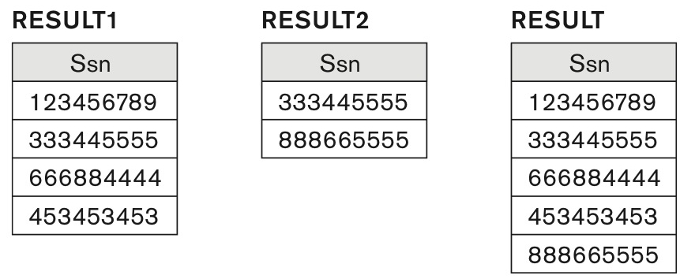
Union operation

Slide 17
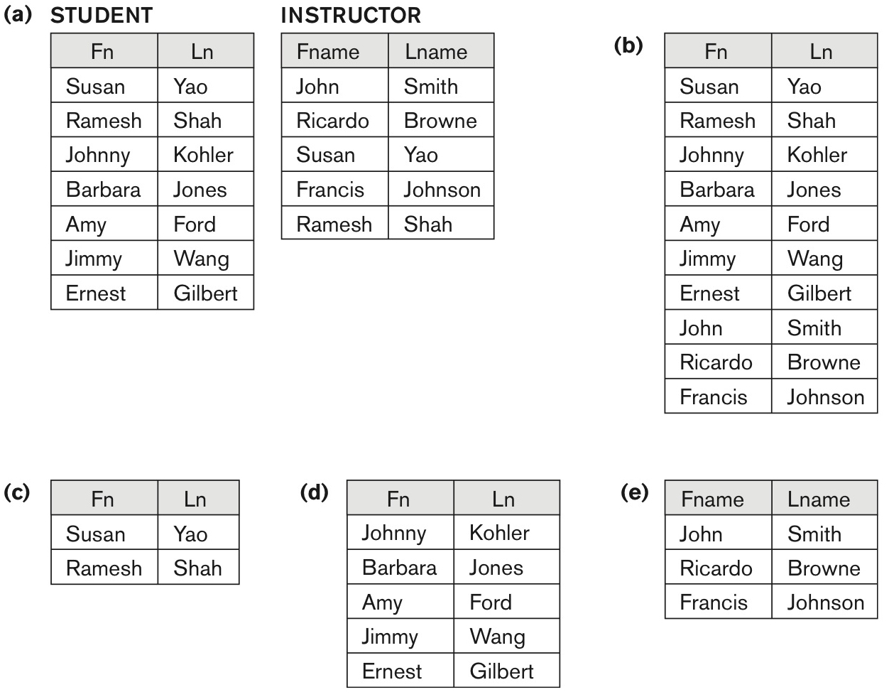
Set operations

Slide 18
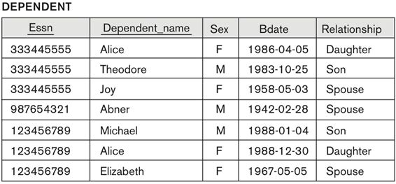
Cartesian Product (or Cross Product) operation
E ← Employee, D ← Dependent
π _{Fname,Lname, Dependent_name} σ_{Ssn = Essn} ((π_{Ssn, Fname,Lname} σ_{Sex=‘F’} E) ✕ D)

Slide 19
Join operation
Natural Join (⋈)
Natural join is a join operation that creates a join on the base of the common columns in the tables.
Equi-Join
Equi-join is a join based on equality or matching column values.

Slide 20
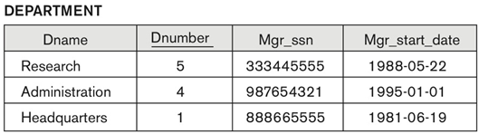
Equi-Join Operation
E ← Employee, D ← Department
π_{Lname,Fname,Dname} (E ⋈_{ssn=Mgr_ssn} D)

Slide 21
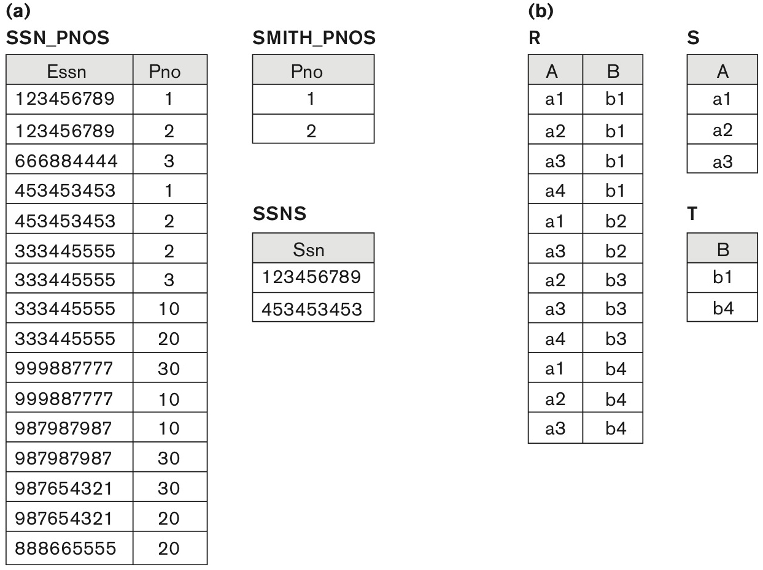
Division Operation
SSN_PNOS / SMITH_PNOS
R / S

Slide 22
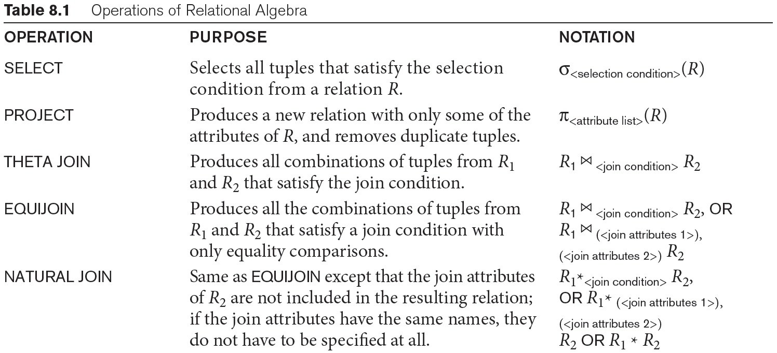
Operations

Slide 23
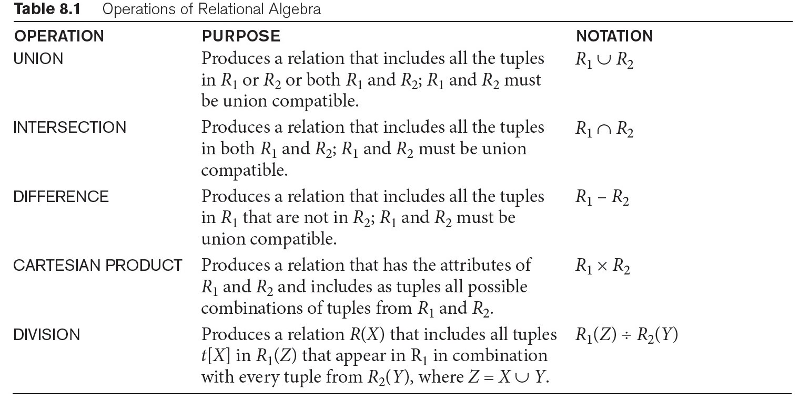
Operations

Slide 24
Complexity of Relational Algebra Operations
Operation | Complexity
Select Project (without duplication elimination) | O(n)
Project (with duplicate elimination) Group by | O(n · log n)
Join Semijoin Division Set Operators | O(n · log n)
Cartesian Product | O (n²)

Slide 25
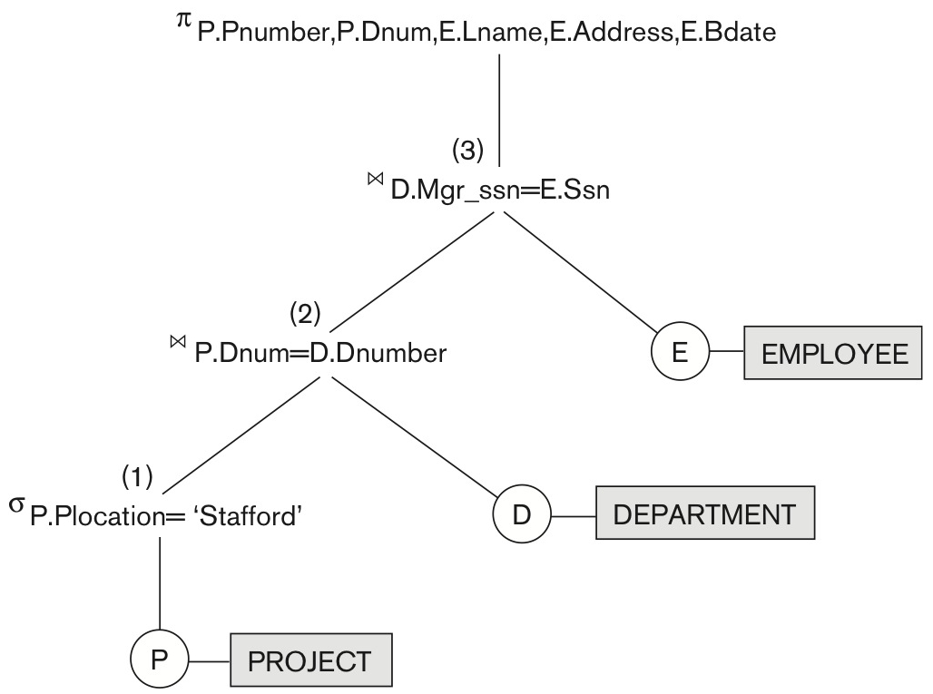
Query tree
P ← Project, D ← Department, E ← Employee
πPnumber,Dnum,Lname,Address,Bdate(σ_{Plocation=‘Stafford’} (P⋈_{Dnum=Dnumber}D) ⋈_{Mgr_ssn = ssn} E)

Slide 26
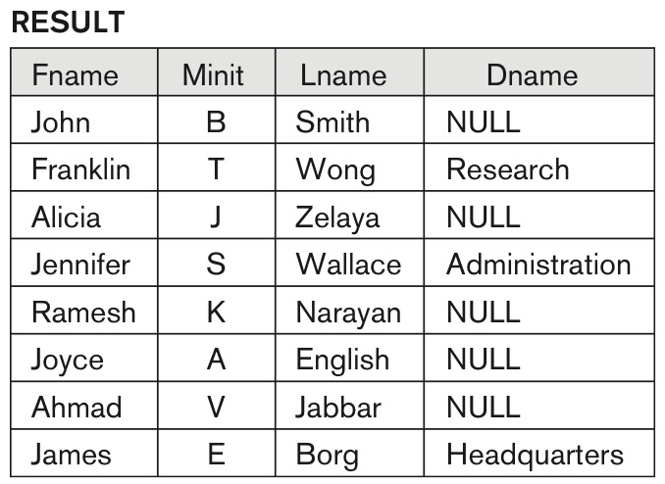
Left Outer Join
E ← Employee, D ← Department
π_{Fname,Minit,Lname,Dname} (E ⟕ _{ssn=Mgr_ssn} D)

Slide 27
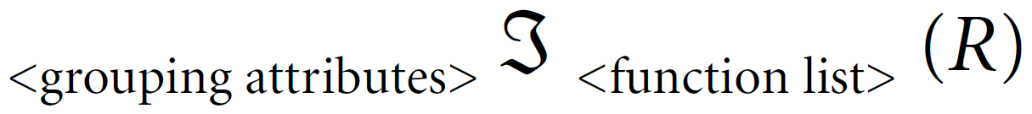
Aggregate Function

Slide 28
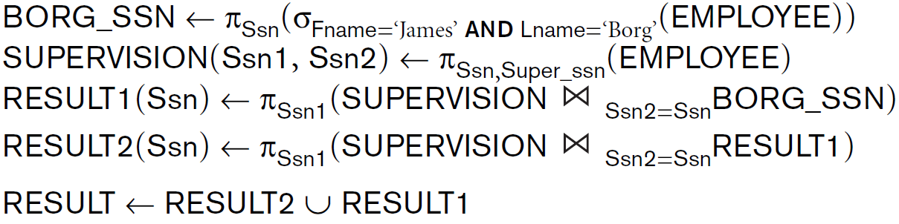
Recursive relationship

Slide 29
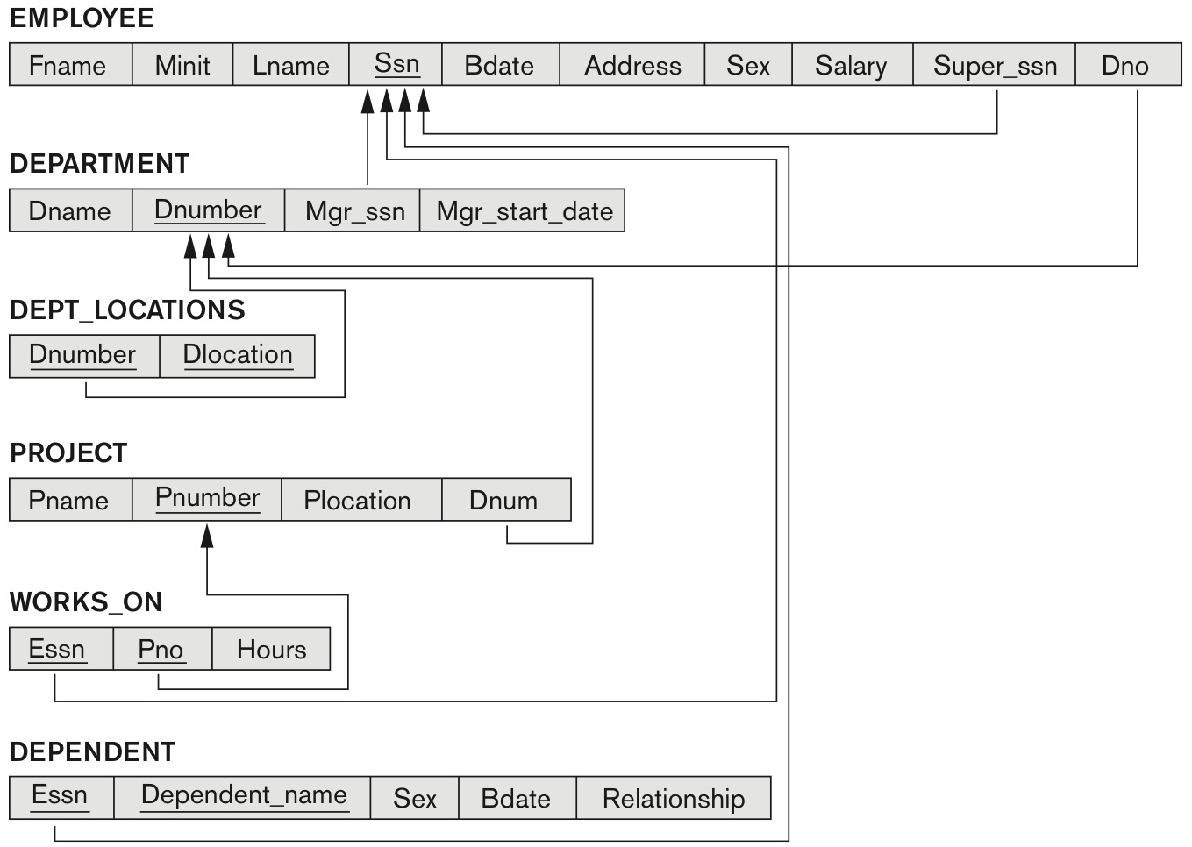
Example

Slide 30
Example

Slide 31
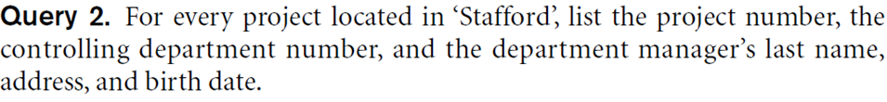
Example

Slide 32
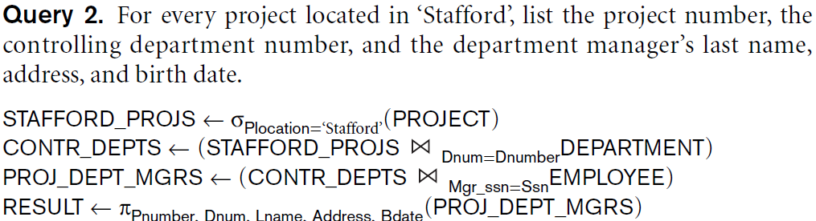
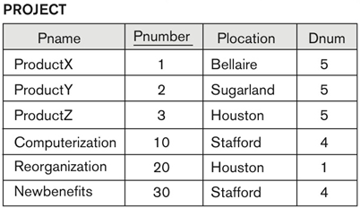
Example

Slide 33
Example

Slide 34
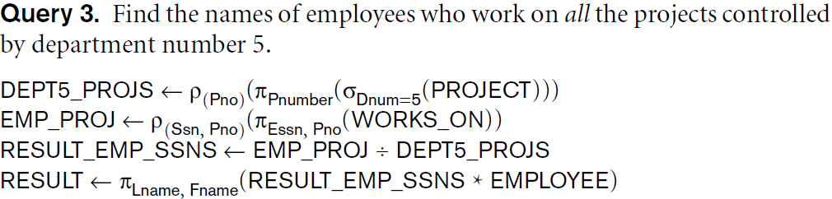
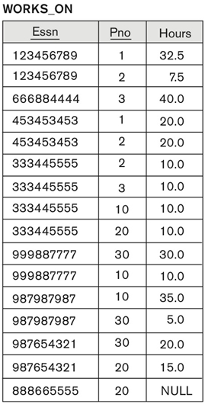
Example

Slide 35
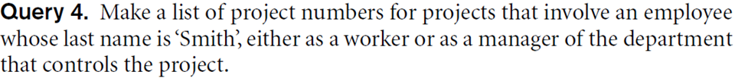
Example

Slide 36
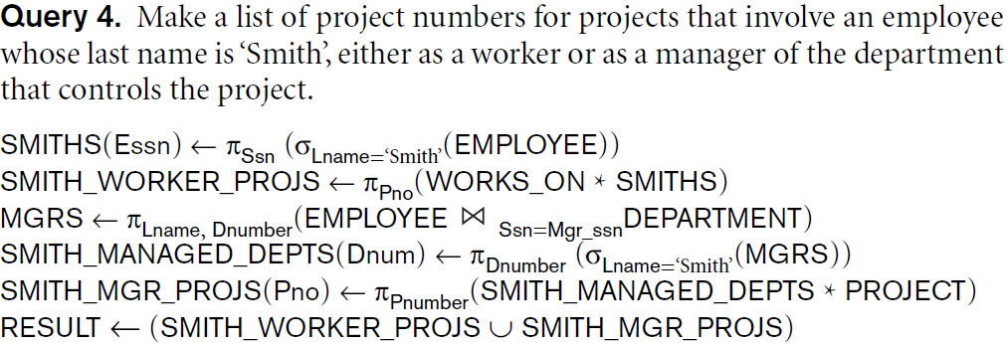
Example

Slide 37
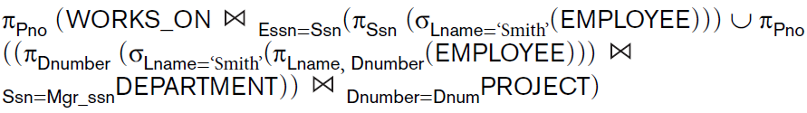
Example

Slide 38
Example

Slide 39
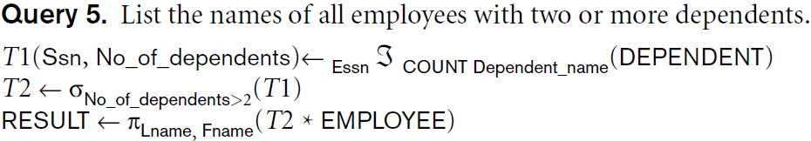
Example

Slide 40
Example

Slide 41
Example

Slide 42
Example

Slide 43
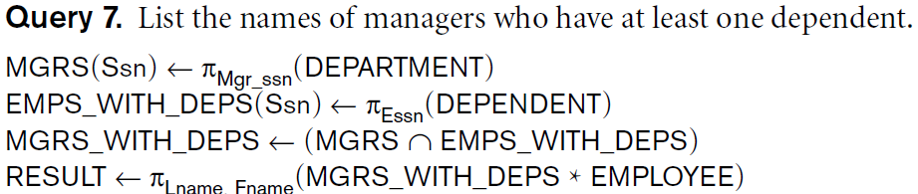
Example

Slide 44
Take home message
Relation Algebra
Selection operation
Projection operation
Assignment operation
Rename operation
Set operations (e.g., union, intersection, difference, division)
Join and Equi-Join
Aggregate Functions and Grouping
Outer Join

